Slide 1
License and Registration
Exploring the data behind police stops and searches

Slide 2

Notes:
Aston Martin DB5 plate flipping to hide his identity

Slide 3
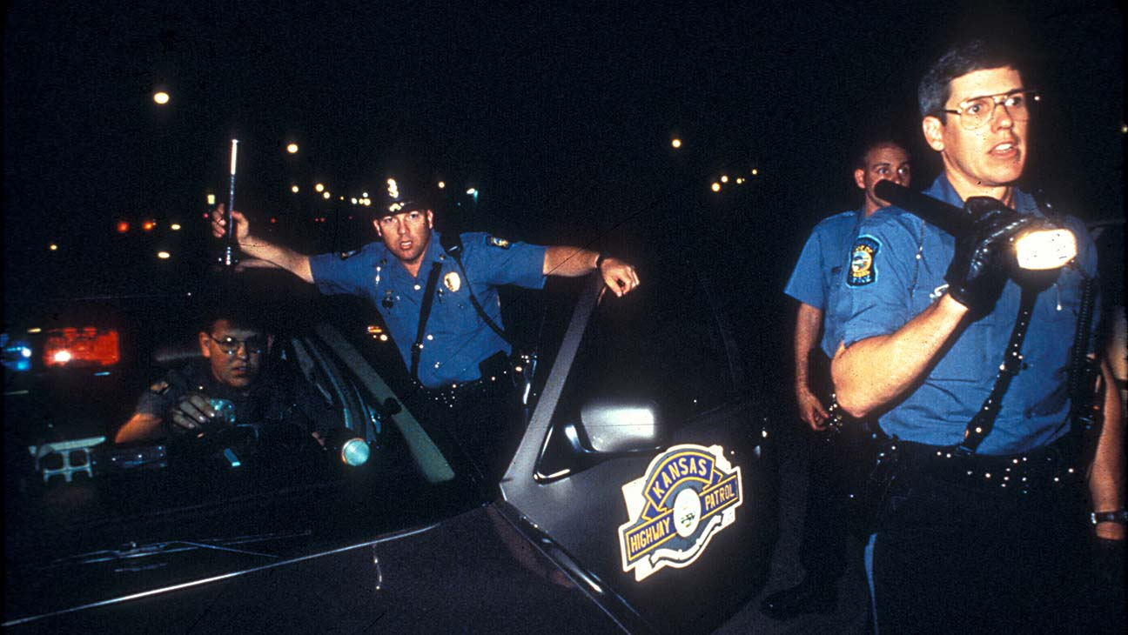
Importance

Slide 4
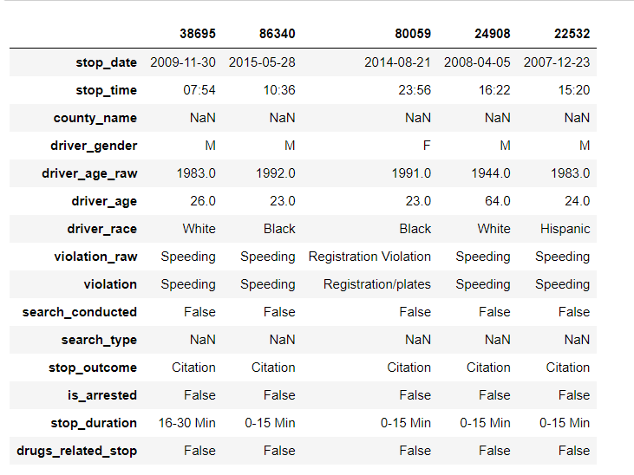
About the Data
Target variable is stop outcome
14 predictor variables
91,741 records

Slide 5
Raw Data Analysis

Slide 6
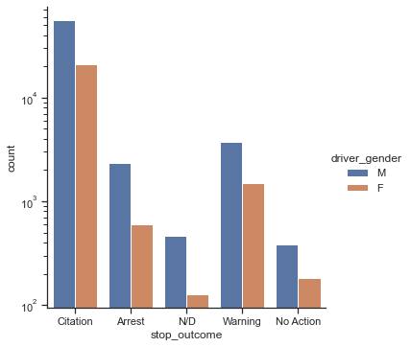
Citations account for ~70,000 instances of the stop outcome (target variable)

Slide 7
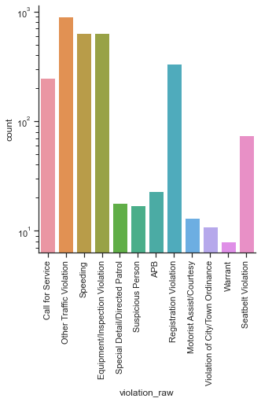
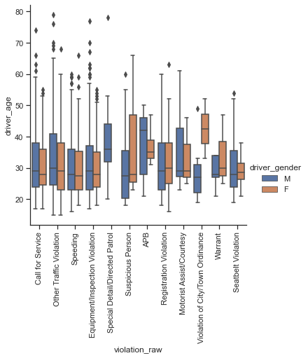
Isolating the data for the other stop outcomes, we find that oversampling techniques will yield accurate results

Slide 8
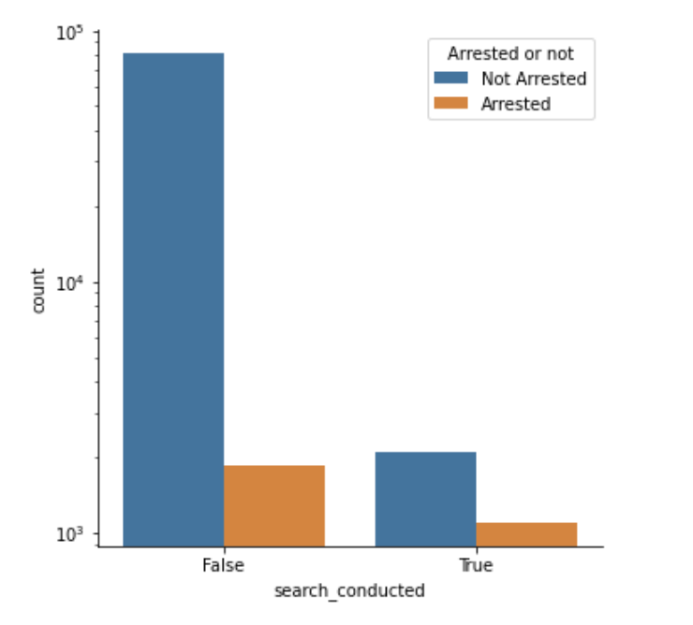
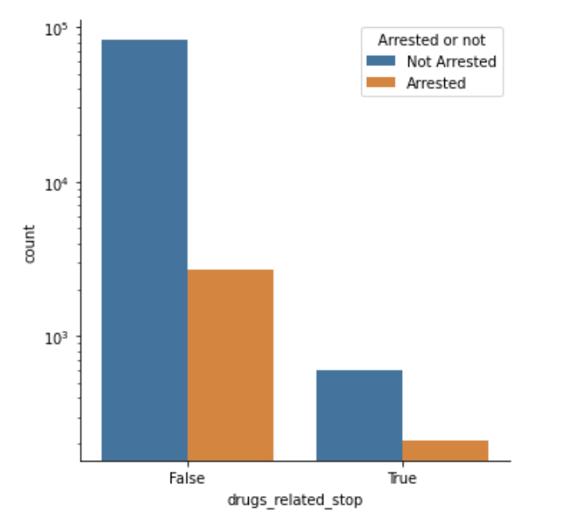
There is a higher proportion of people who have been searched getting arrested than people who have not been searched.
There is a higher proportion of people who did not have drug related stops getting arrested than those who have.

Slide 9
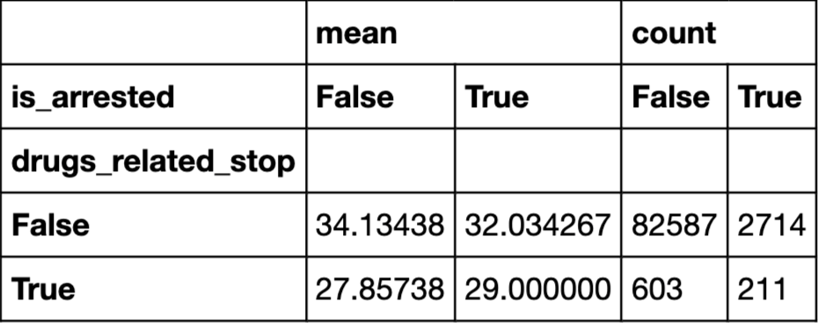
1)Male drivers who are stopped because of drugs are generally older.
2)Among people who are stopped because of drugs, those that are not arrested are generally younger than those who are arrested on average.
3)Among people who are stopped because of other reasons, those that are arrested are generally younger than those that are not.

Slide 10
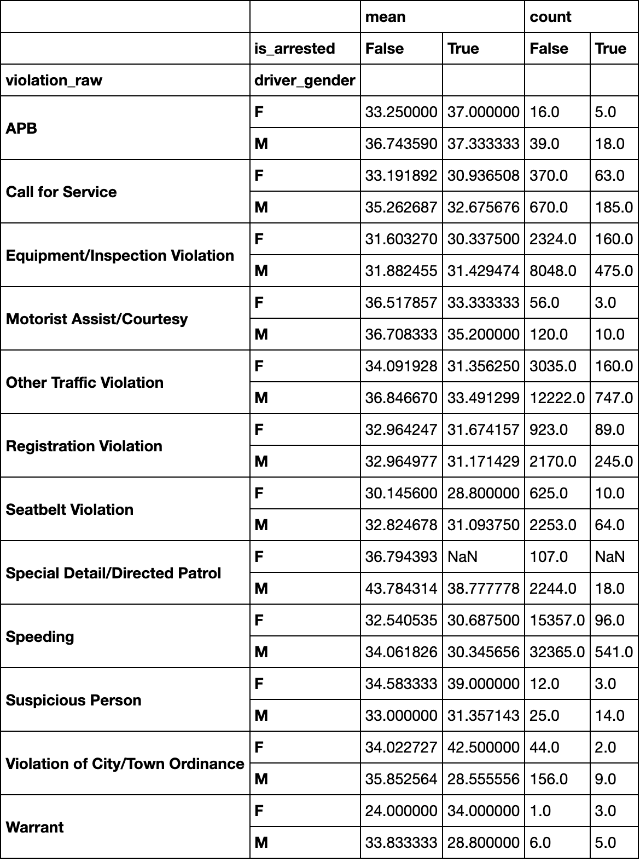
People who have violation are mostly around 35 years old on average, and people who violate for special detail and directed patrol are generally older.
People who are caught for equipment or inspection violation generally correlate less to getting arrested.
In contrast, people who are caught because they are suspicious correlate more to getting arrested.

Slide 11
Time Data Wrangling

Slide 12
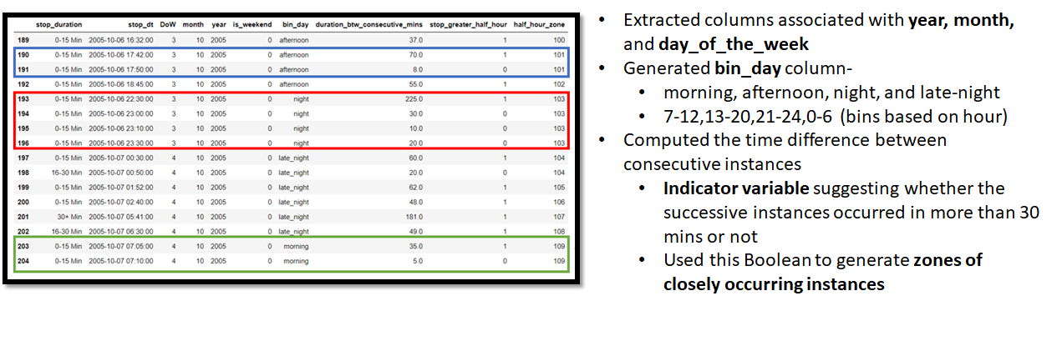

Slide 13
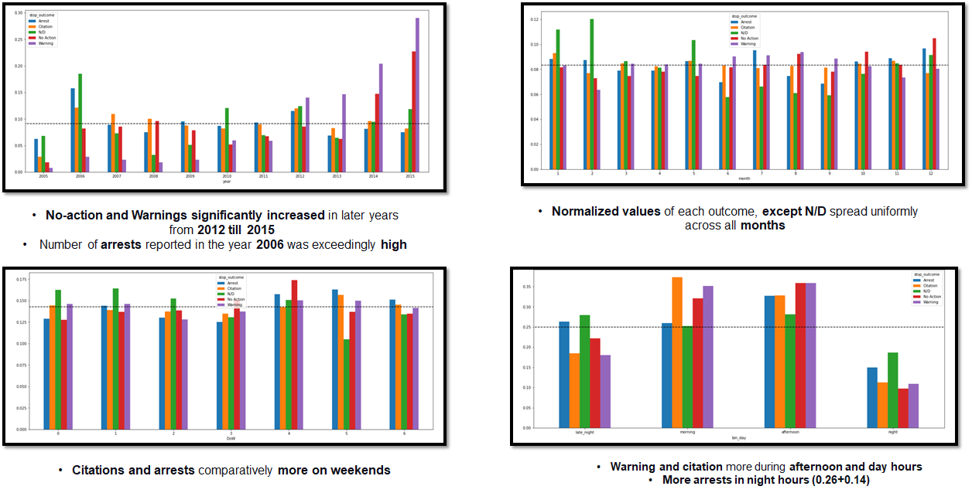

Slide 14
Inferential Analysis

Slide 15
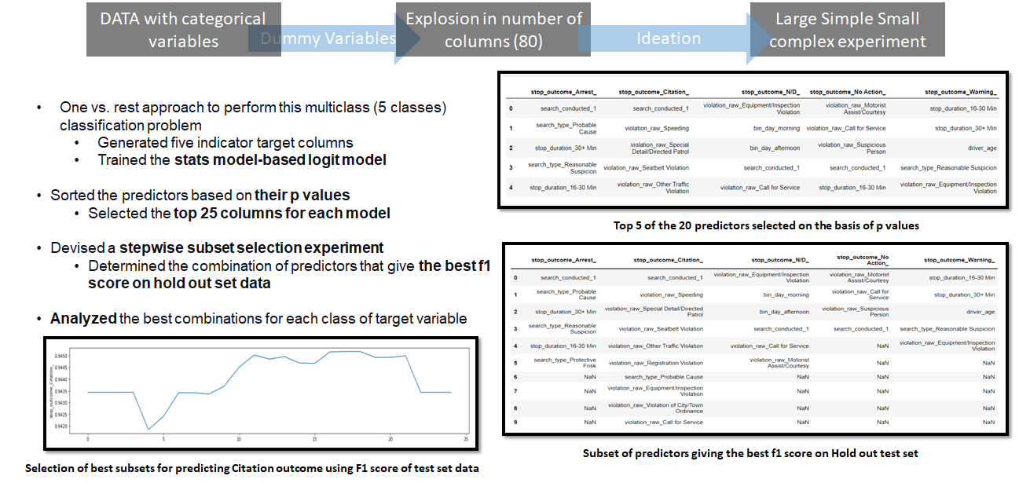

Slide 16
Predictive Analysis

Slide 17




Data prep
One Hot Encoding
Drop Values
Normalization
Data Augmentation
Notes:
Had to one hot encode categories
Dropping N/D and No Action values
Need to standardize values that are greater than 1
Random undersampling and SMOTE Oversample

Slide 18
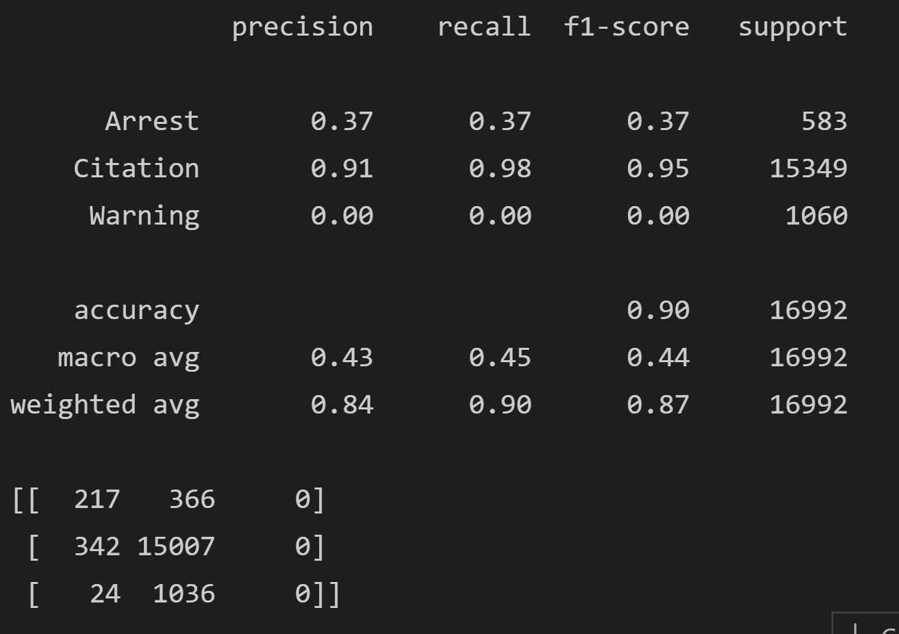
Before Oversampling - Naive Bayes
Notes:
Without data augmentation, it is always predicting the most seen class because that is all it is learning

Slide 19
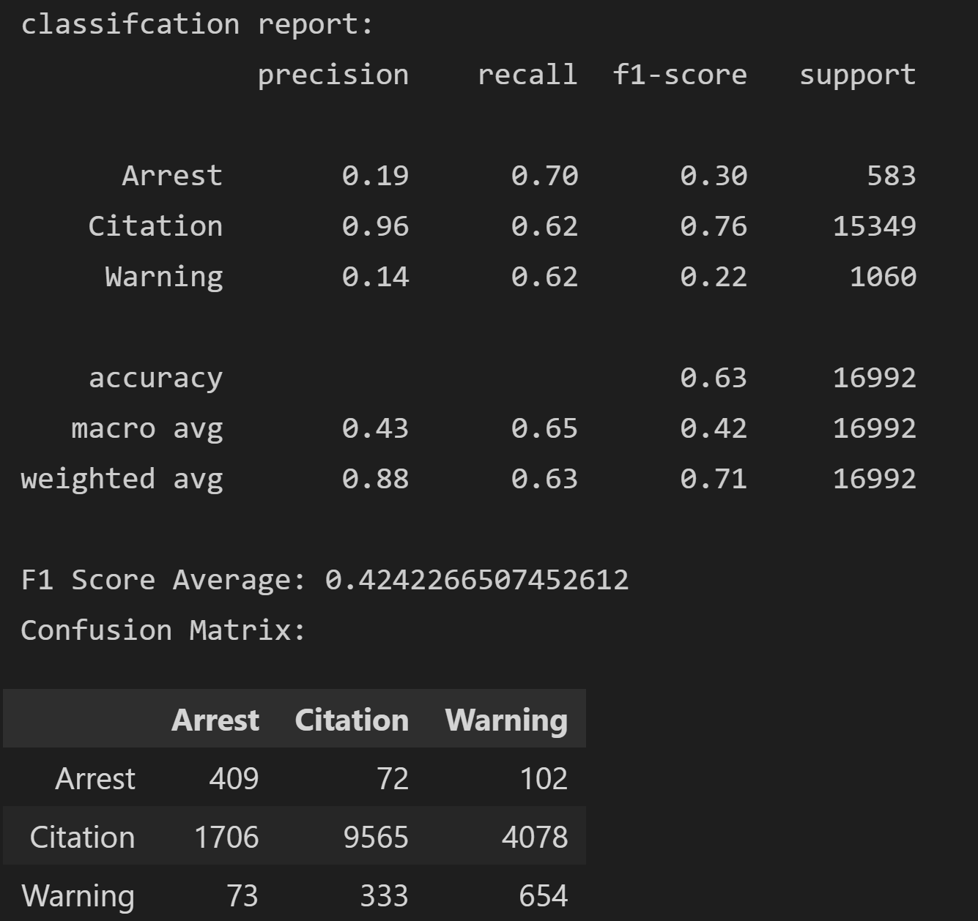
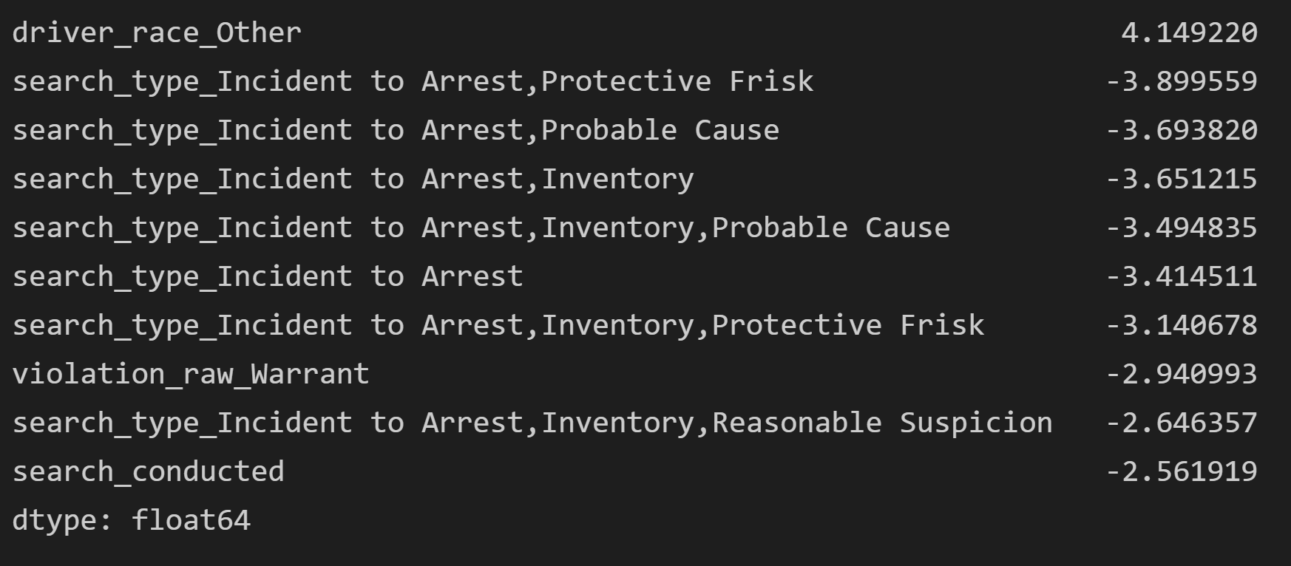
Naive Bayes
Notes:
Much better results. All the recall values are above .5 and the F1 score improved.

Slide 20
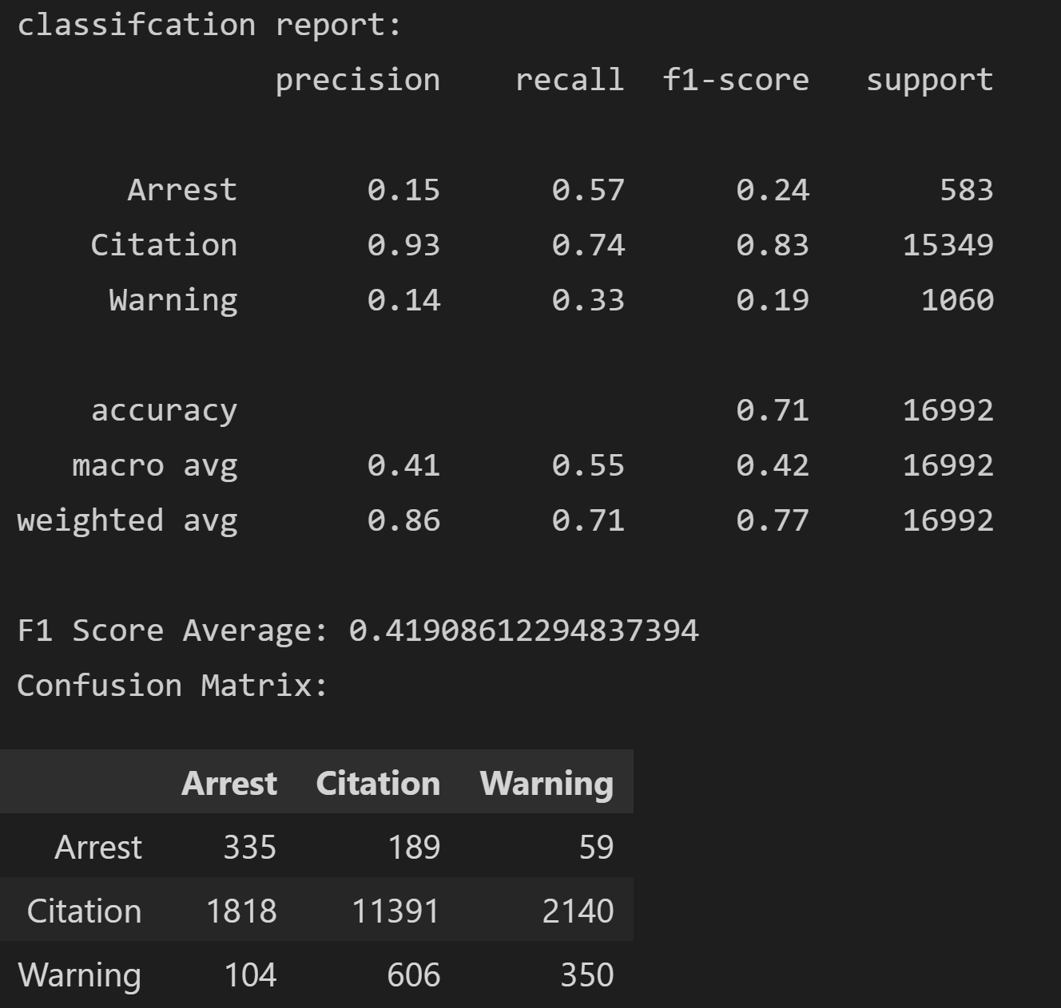
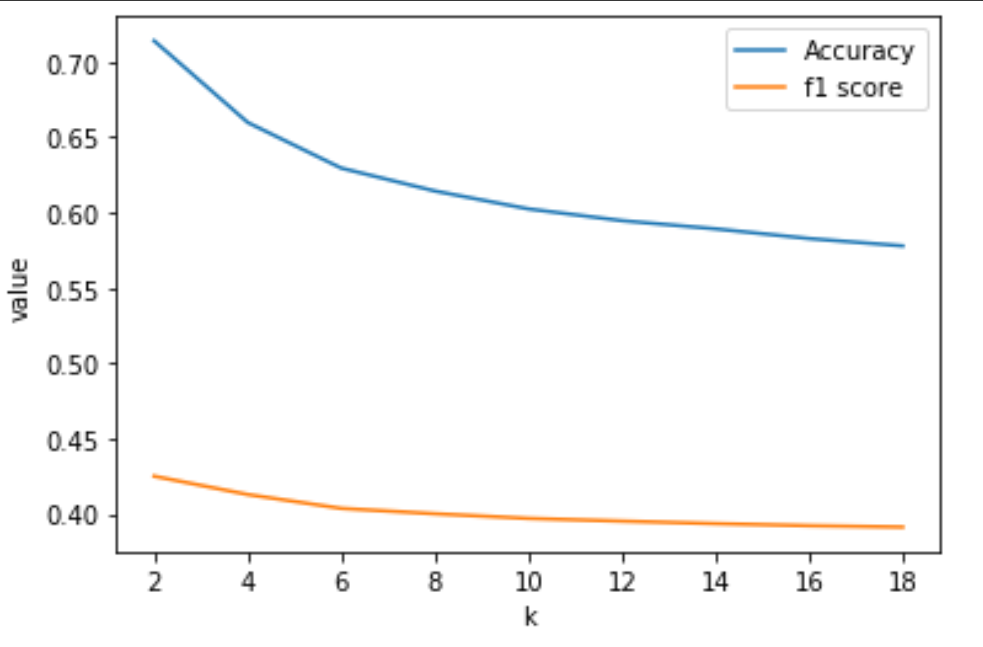
KNN

Slide 21
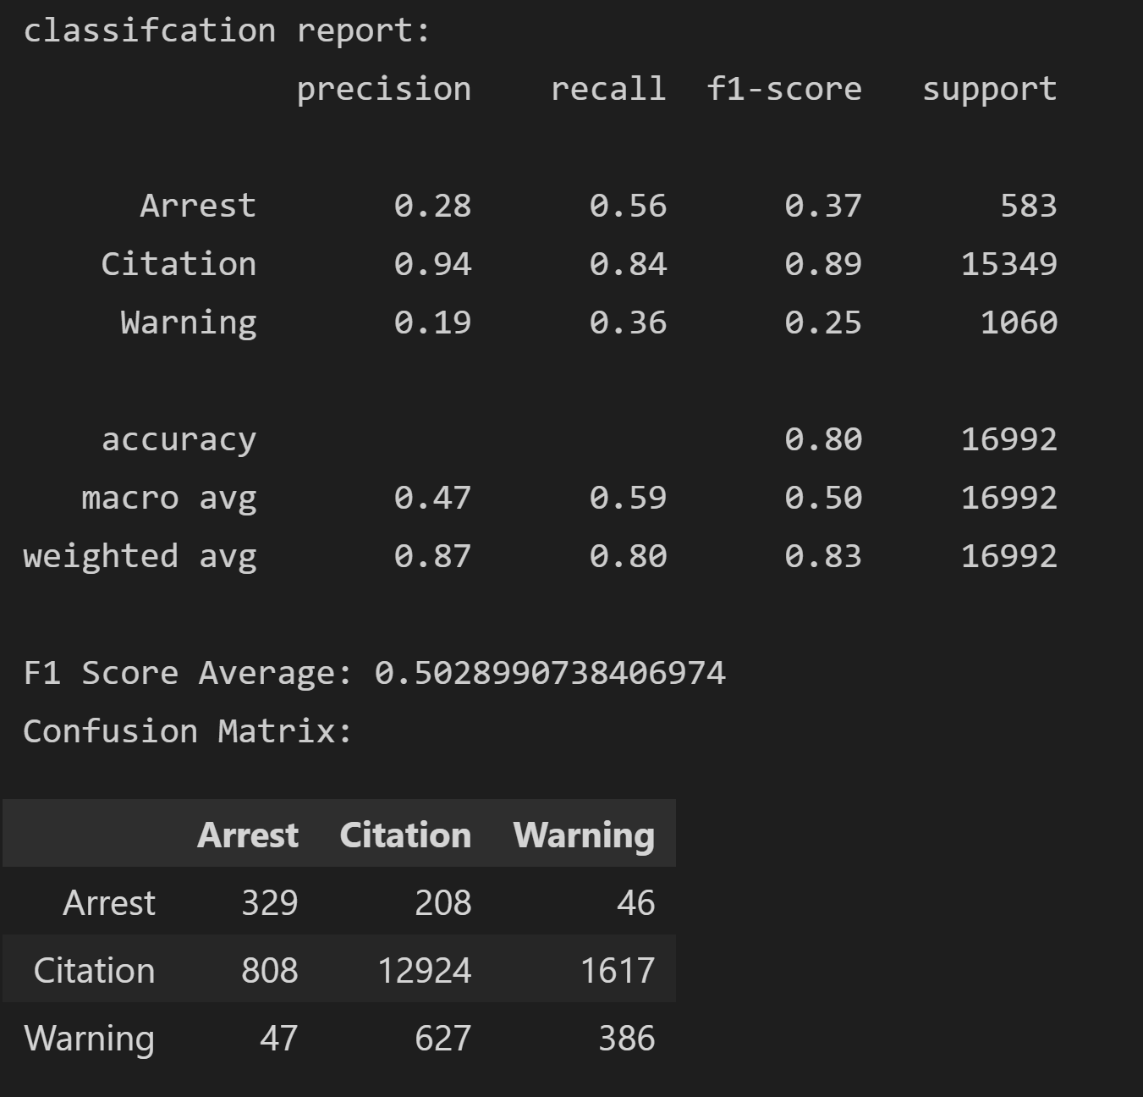
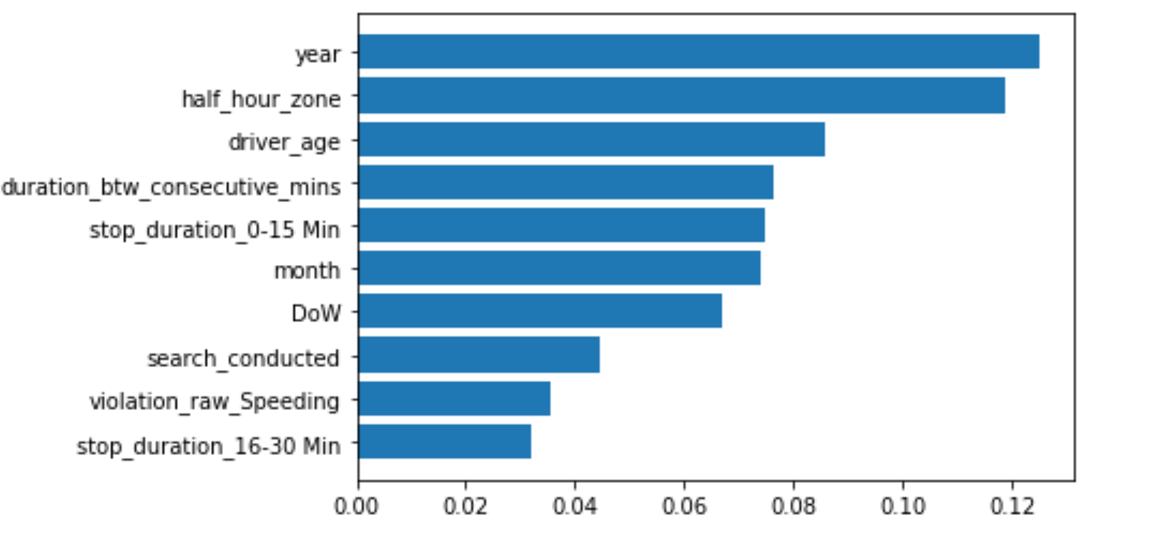
Random Forests
Notes:
Getting confused on citation and warning

Slide 22
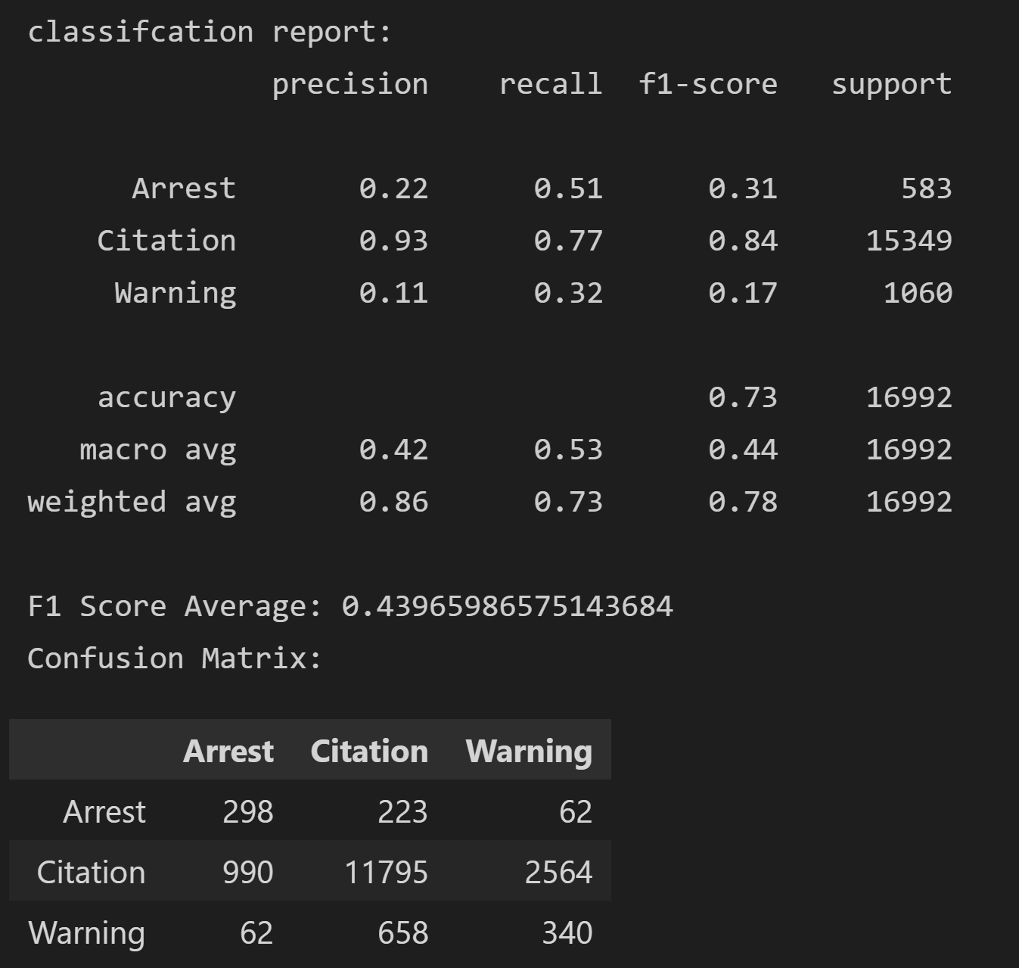
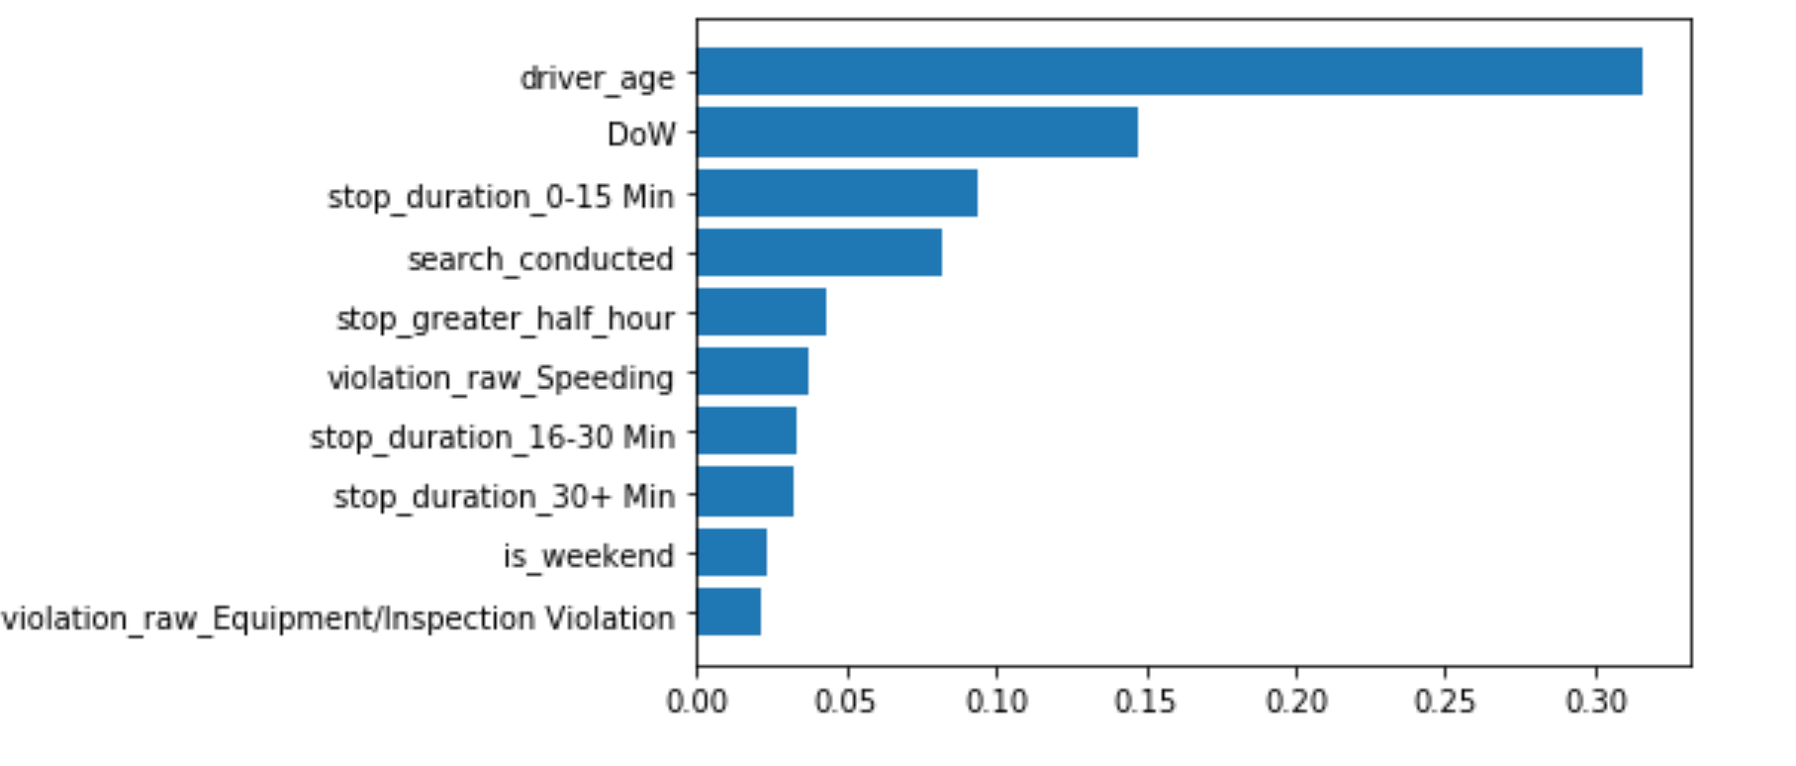
Random Forest (Cleaned Data)

Slide 23
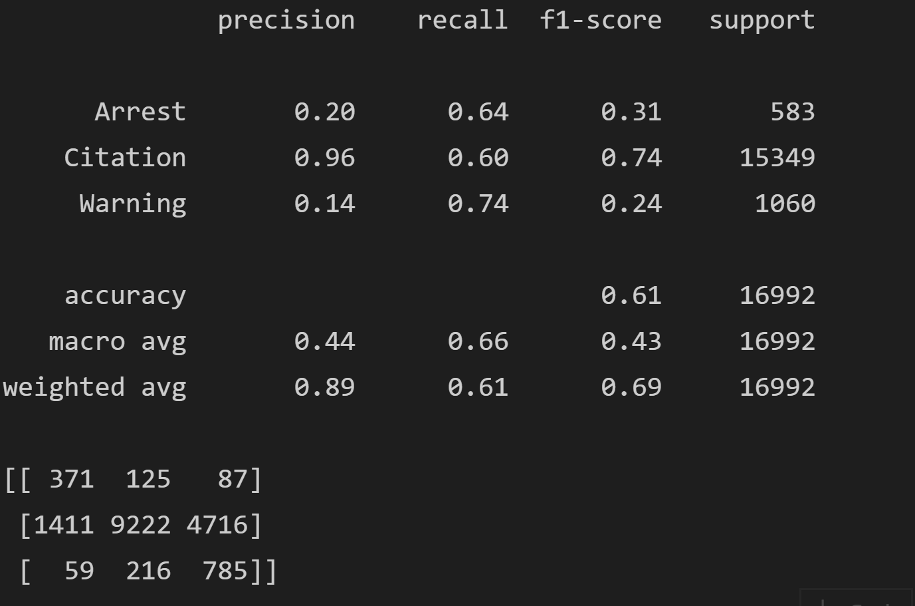
Other Models - SVM

Slide 24
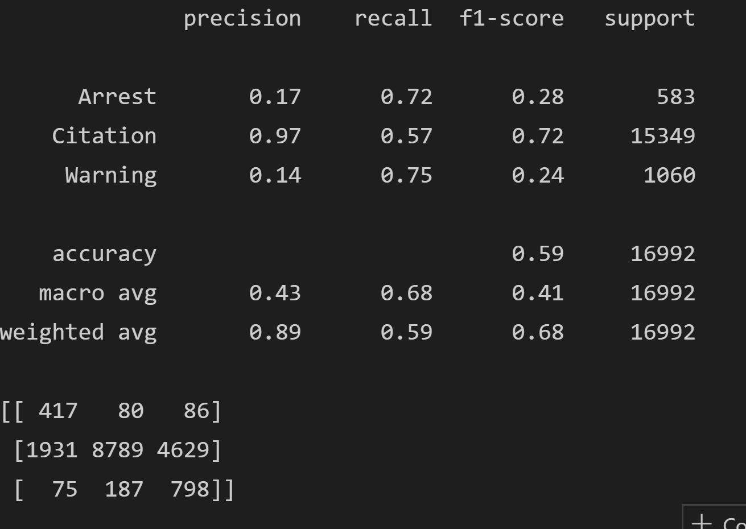
Other Models - Logistic Regression

Slide 25
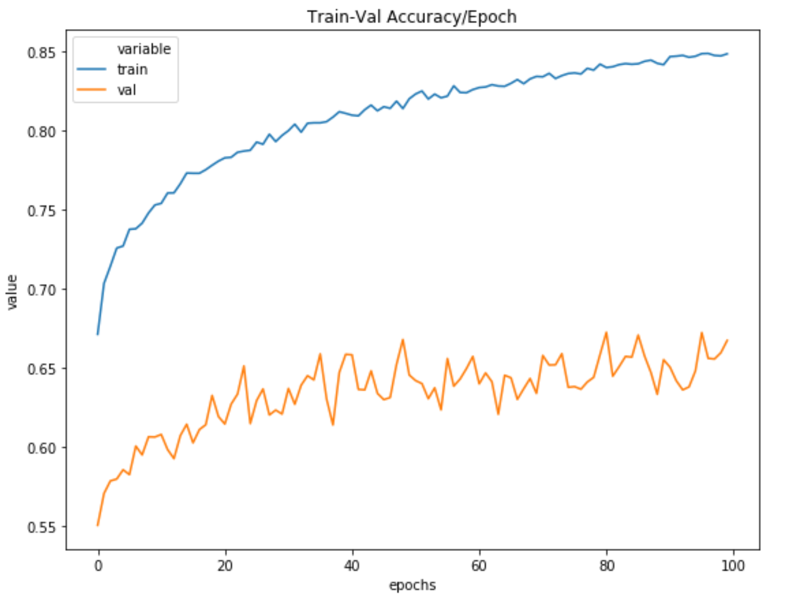
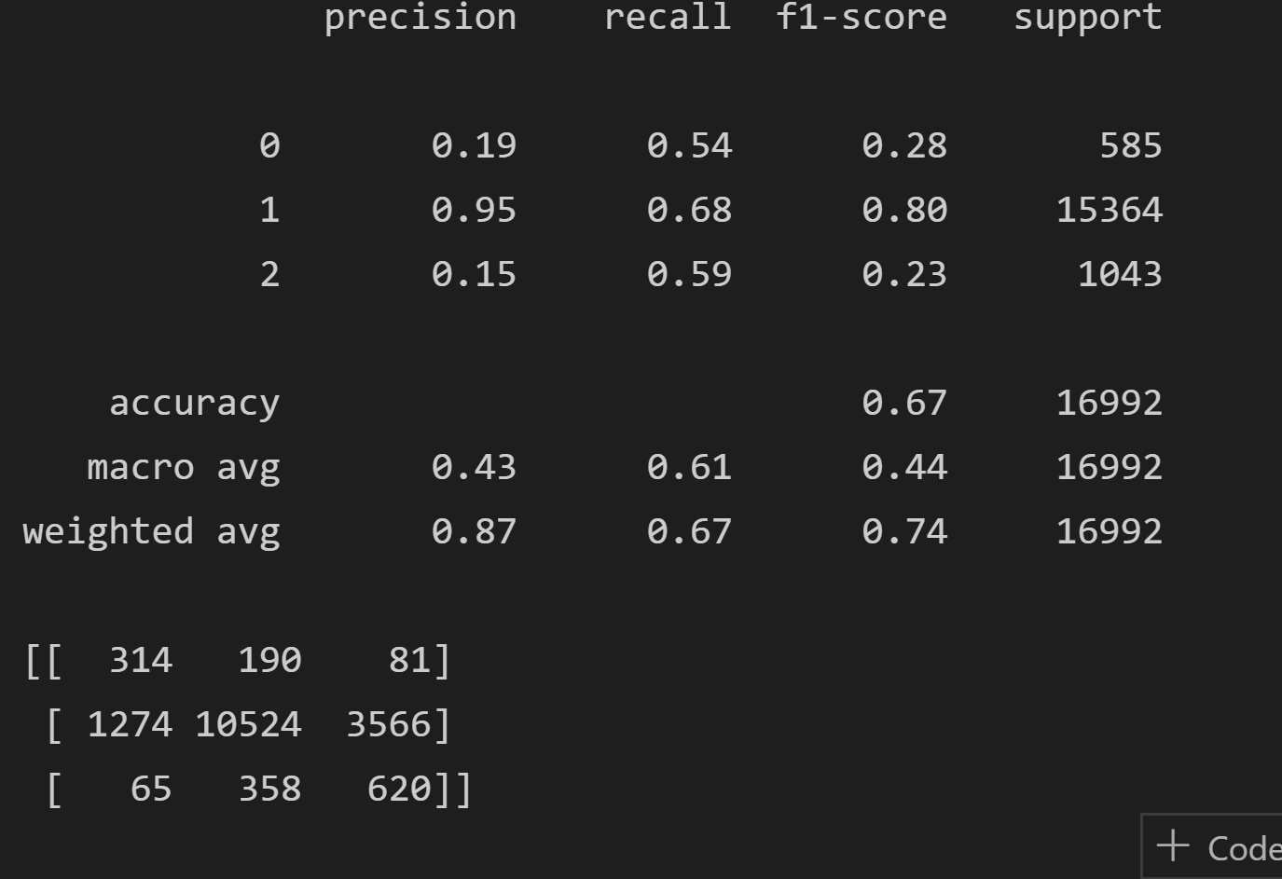
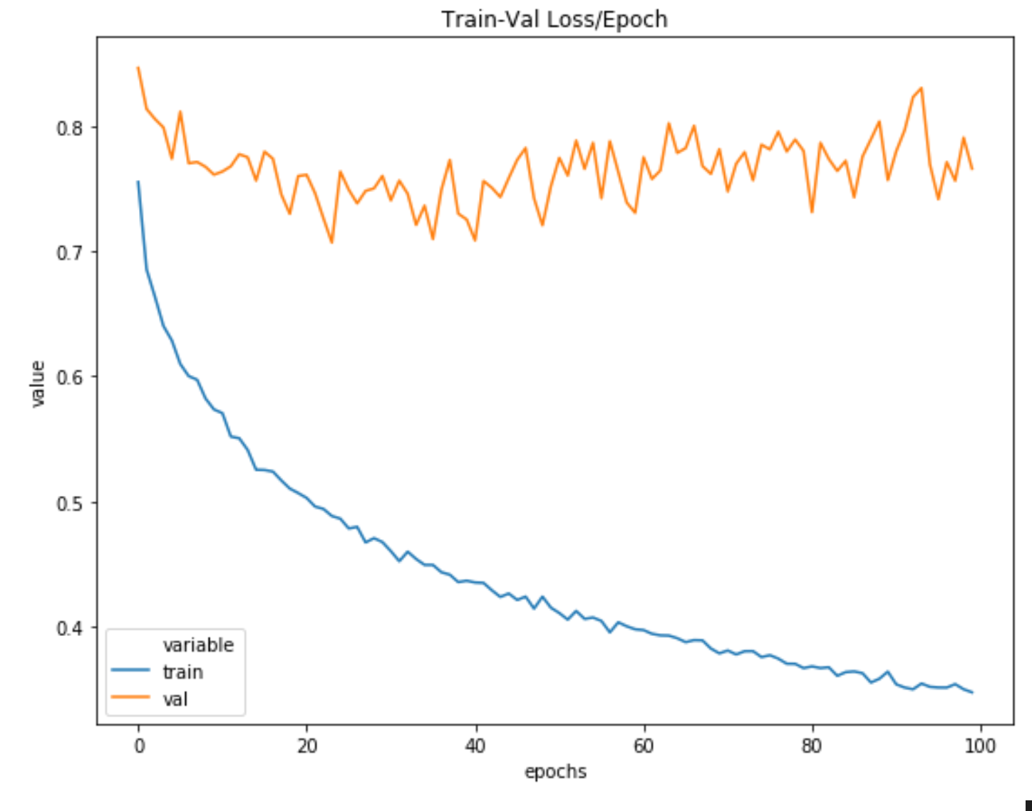
Other Models - Neutral Network (PyTorch)

Slide 26
Conclusion

Slide 27



Takeaways
Data Insights
Model Results
Improvements
Notes:
Data Insights:
Based on the data analysis and study, it is interesting to see how year has a strong correlation with the outcome and features such as drugs do not. We have found many other trends with in the data as well.
Model Results
Data augmentation was needed for the model to train
it is seen that the model tends to misclassify between warning and citation more often then arrest and citation
This could be because warnings are very similar to citations and are given on a case-by-case basis on unrecorded factors such as if the driver has been pulled for the first time.
However, the model does predict better than random and some models, such as Naive Bayes, Logistic Regression, Neural Networks, have recall scores of above 0.50 for all classes, predicting true values more often for each outcome.
Improvements
Reducing the number of dimension to protect against curse of dimensionality. Can be done using PCA or removing features
Ensembling models
Further hyperparameter tuning (couldn’t because of time and resources)
Gathering more raw data on the minority classes

Slide 28
Thank you!

